Slide 1


Procedure Call Stack (SP Register)
Haijian Sun
sunh@uww.edu

Slide 2
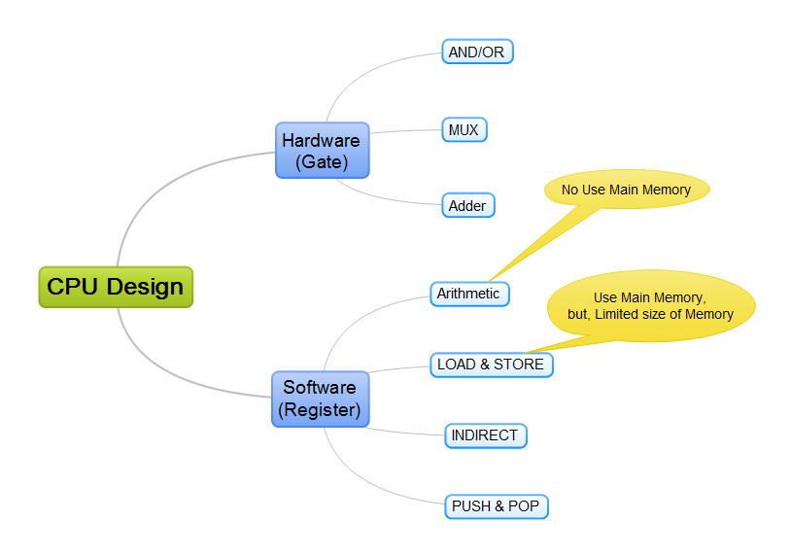
Learning Object
Use More Main Memory
Notes:
HW: Circuit Design

Slide 3
Learning Object
(Preserved) Register
ir (instruction register): next instruction which will execute
sp (stack pointer): point current stack location
lr (link register): return location after finishing sub function.
pc (program counter): current program/code address
Register | Binary
r4, ir | 100
r5, sp | 101
r6, lr | 110
r7, pc | 111

Slide 4

Current Your Computer
Need more function in the limited resource.
Let’s use special purpose 4 registers
Like, Basic Programming Language
Basic Calculator
+,-,/,*
Store and Load variable on the main memory
Large number
Now, we want to more function
Call Function
Parameter, variables, return
More, Advanced Programming Languge

Slide 5
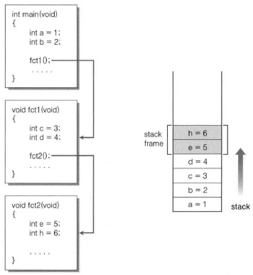
Local Variable
Programming function
Use Variables such as local variable, global variable
Stack
Local variable is saved in stack
Stack Frame
Memory space for local variables on a function
Stack Point (sp) register
Point the current location on stack
SP
Notes:
To use local variable in main memory we need to know the three components.

Slide 6
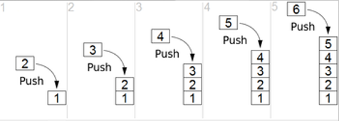
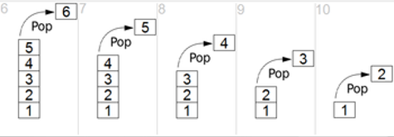
Stack
Stack (Last In, Frist Out)
Memory space for local variable
In computer science, a stack is an abstract data type that serves as a collection of elements (data), with two principal operations:
Push (write): add an element/data to the collection
Pop (read): removes the most recently added element/data that was not yet removed in memory

Slide 7
Stack Frame
Stack Frame (SF)
Memory block which is allocated memory for local variable.
Main function’s SF
a=1, b=2 in memory.
fc1 function’s SF
c=3, d=4 in memory.
fc2 function’s SF
e=5, h=6 in memory.
Stack Frame

Slide 8

Stack Frame
Computer stack the element/data in memory
How did the CPU get to know where the next location?
Save the top of stack’s address
SP Register

Slide 9
Flow of Stack Pointer 1
Stack Pointer (SP) register
Point next address
int main(void)
{
int a = 1;
int b = 2;
fc1();
}
Flow of code
r0
r1
r2
int fc1(void)
{
int c = 3;
int d = 4;
fc2();
}
r3
r4 ir
r5 sp
r6 lr
r7 pc
Start sp
int fc2(void)
{
int e = 5;
int f = 6;
}
Notes:
How to work

Slide 10
Flow of Stack Pointer 1
Stack Pointer (SP) register
point next address
int main(void)
{
int a =1;
int b =2;
fc1();
}
Flow of code
r0
r1
r2
int fc1(void)
{
int c =3;
int d =4;
fc2();
}
r3
r4 ir
r5 sp
r6 lr
r7 pc
increase sp value
int fc2(void)
{
int e =6;
int f =5;
}
a = 1

Slide 11
Flow of Stack Pointer 2
Start main function
Stack variable a and b
int main(void)
{
int a = 1;
int b = 2;
fc1();
}
Flow of code
r0
r1
r2
int fc1(void)
{
int c = 3;
int d = 4;
fc2();
}
r3
r4 ir
r5 sp
r6 lr
increase sp value
r7 pc
b = 2
int fc2(void)
{
int e = 5;
int f = 6;
}
a = 1

Slide 12
Flow of Stack Pointer 3
Call fc1 function from main function
Stack variable c
int main(void)
{
int a = 1;
int b = 2;
fc1();
}
Flow of code
r0
r1
r2
int fc1(void)
{
int c = 3;
int d = 4;
fc2();
}
r3
r4 ir
r5 sp
r6 lr
increase sp value
c = 3
r7 pc
b = 2
int fc2(void)
{
int e = 5;
int f = 6;
}
a = 1

Slide 13
Flow of Stack Pointer 4
Call fc1 function from main function
Stack variable d
int main(void)
{
int a = 1;
int b = 2;
fc1();
}
Flow of code
r0
r1
r2
int fc1(void)
{
int c = 3;
int d = 4;
fc2();
}
r3
r4 ir
r5 sp
increase sp value
d = 4
r6 lr
c = 3
r7 pc
b = 2
int fc2(void)
{
int e = 5;
int f = 6;
}
a = 1

Slide 14
Flow of Stack Pointer 5
Call fc2 function from fc1 function
Stack variable d
int main(void)
{
int a = 1;
int b = 2;
fc1();
}
Flow of code
r0
r1
r2
int fc1(void)
{
int c = 3;
int d = 4;
fc2();
}
r3
r4 ir
e = 5
r5 sp
increase sp value
d = 4
r6 lr
c = 3
r7 pc
b = 2
int fc2(void)
{
int e = 5;
int f = 6;
}
a = 1

Slide 15
Flow of Stack Pointer 6
Call fc2 function from fc1 function
Stack variable d
int main(void)
{
int a = 1;
int b = 2;
fc1();
}
Flow of code
r0
r1
r2
int fc1(void)
{
int c = 3;
int d = 4;
fc2();
}
r3
f = 6
r4 ir
Final SP
e = 5
r5 sp
d = 4
r6 lr
c = 3
r7 pc
b = 2
int fc2(void)
{
int e = 5;
int f = 6;
}
a = 1

Slide 16
Practices
Fill out the (green) main memory
Show the arrow of sp register
int main(void)
{
int a = 1;
int b = 2;
fc2();
}
r0
r1
r2
int fc1(void)
{
int c = 3;
int d = 4;
}
r3
r4 ir
r5 sp
r6 lr
r7 pc
int fc2(void)
{
int e = 5;
int f = 6;
fc1();
}

Slide 17
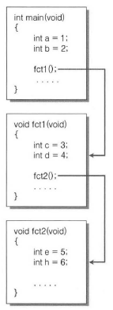
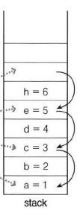

Summary
Stack Pointer (SP) register
Increasing value when allocated variable (point next address)
return
Decreasing value when function is finished
How to know the amount memory that is released when return function
Final sp
Return fc2
Before call fc2
Return fc1
Before call fc1
Start sp
I need backup a register for return memory.
SP Register
I need backup a register for return address.

